Slide 1
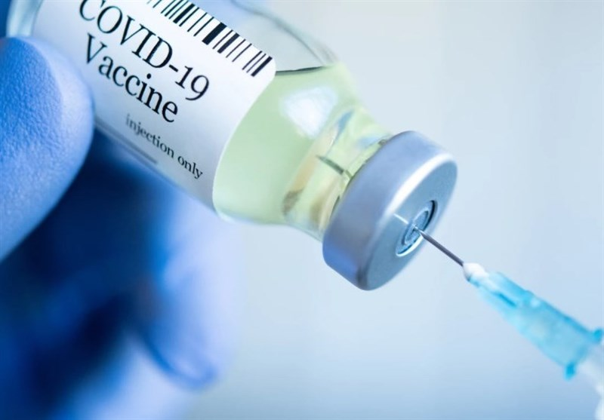

AML 2404 AI and ML Lab
Team: AI BOTS
Topic: Covid 19 Vaccination rate analysis and forecasting across Canada
Instructor: Parisa Naraei
Group Members:
Ananya Singh(C0800598)
Jacob Sebastian(C0806499)
Prachi Shah(C0820195)
Sreeraj Sudhakaran(C0805420)
This Photo by Unknown Author is licensed under CC BY

Slide 2
Problem Use Case
Covid 19 Vaccination rate analysis and forecasting across Canada
We would be collecting datasets related to covid 19 vaccination across Canada and analyse the dataset
Our main aim for this project is to create a solution which would help the Health department in stocking up the vaccine doses as it is tough to get acquire a dose as Canada does not produce vaccine domestically

Slide 3

Data Set
For our project we used 3 different datasets from https://health-infobase.canada.ca/covid-19/
The 3 datasets contains details regarding vaccination coverage,vaccination coverage by age and sex,vaccination coverage by vaccine type across Canada.
This site is owned and operated by the Govt of Canada and the vaccination data is updated every Friday
We are accessing the datasets in CSV format

Slide 4
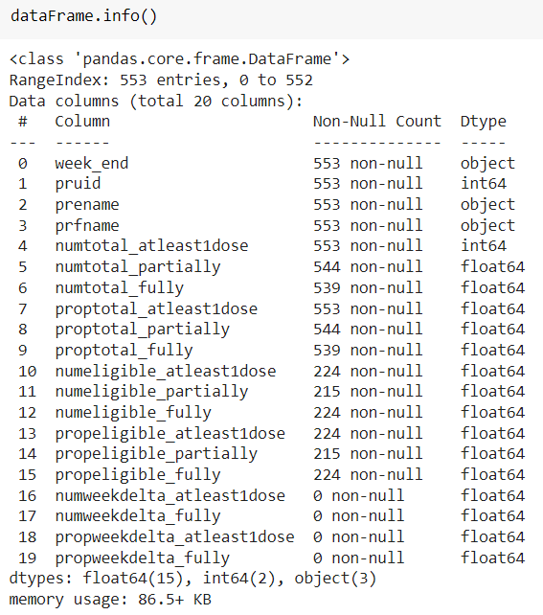
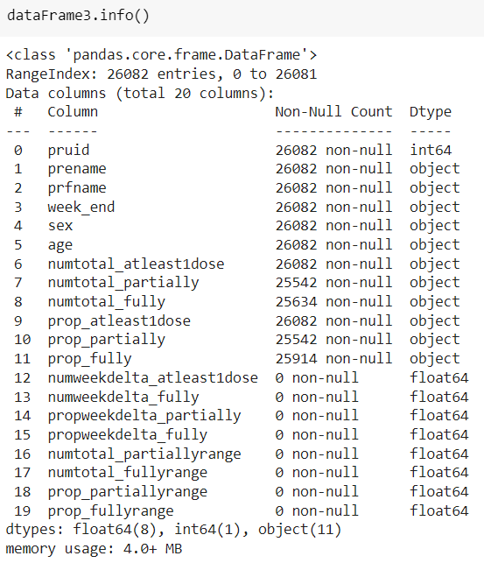
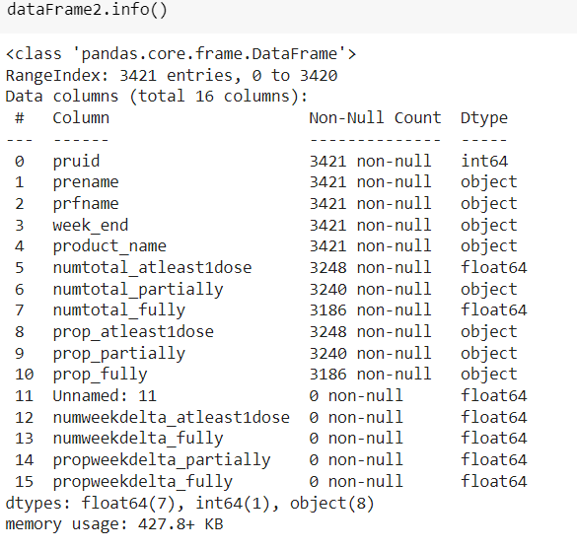
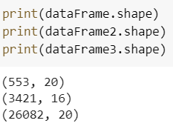
We identify the shape of our datasets to
understand the volume of the data we will
handling
We explore which all datatypes are present
in each of our datasets and how many row
instances have null /missing values
Exploratory Data Analysis (EDA)

Slide 5
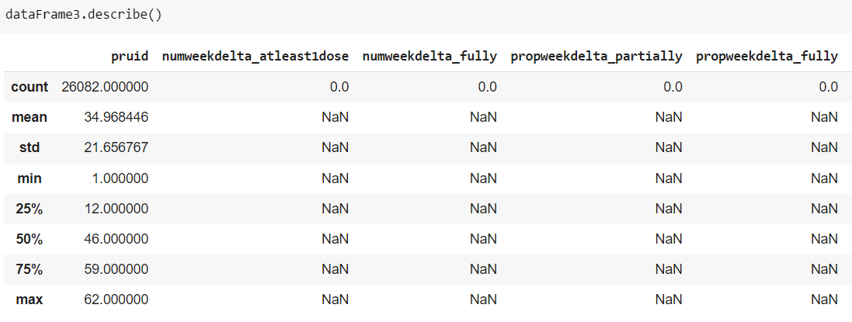
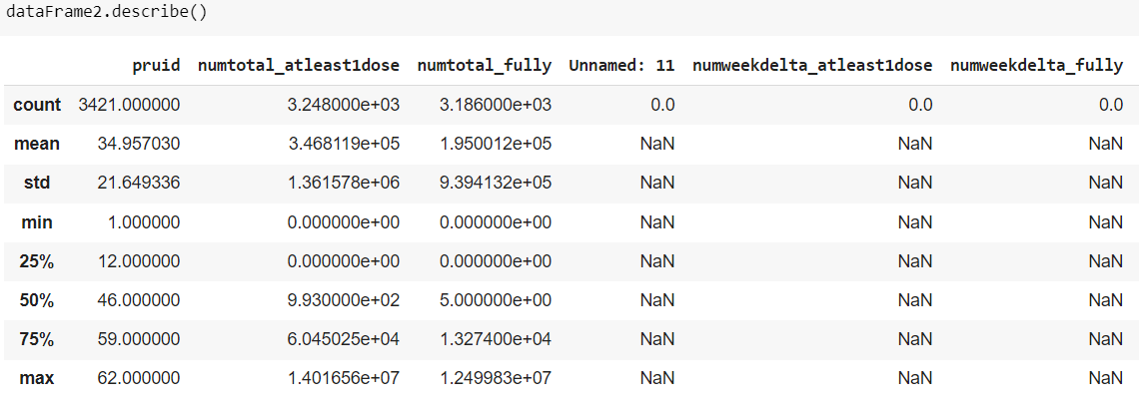
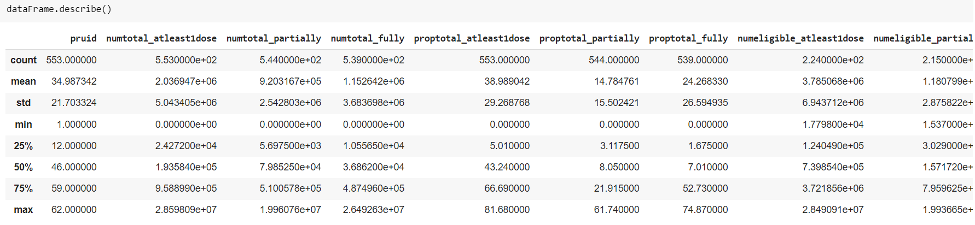
We analyse the statistical insights of our datasets
Even though we have 3 datasets we were not able to merge them together due to uneven dimensions
We would be applying forecasting on key features within the 3 datasets
Performed data cleaning process where the null/missing values either by removing the data or imputing the missing values

Slide 6
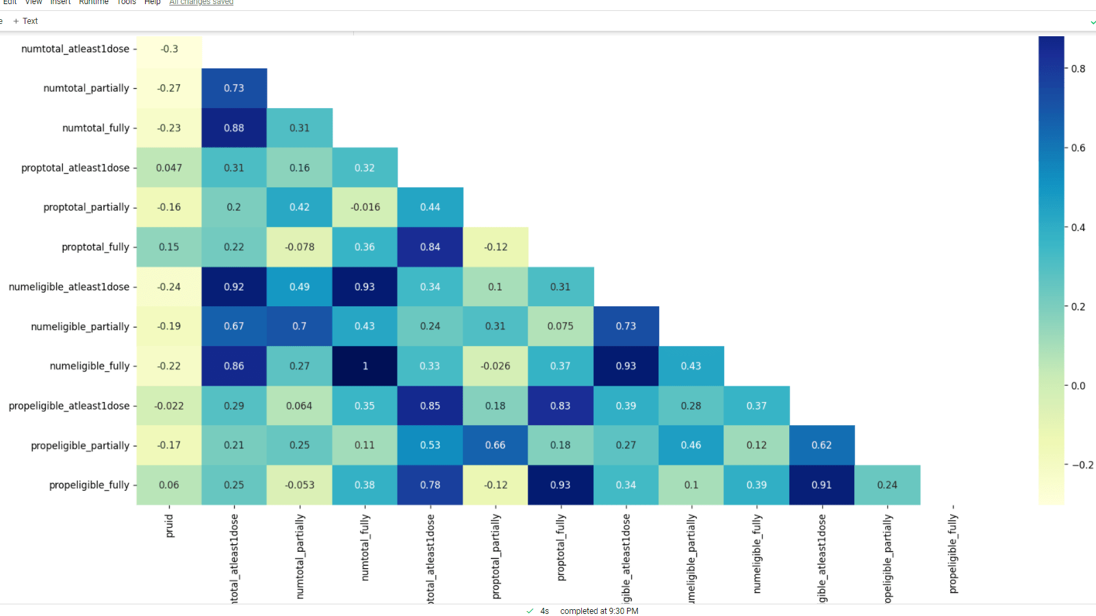
HEATMAPS
DATA VISUALIZATION
The value of correlation can take any values from -1 to 1.
The dark blue color represents the highly correlated features.
The lightest blue color represents the least correlated features.

Slide 7
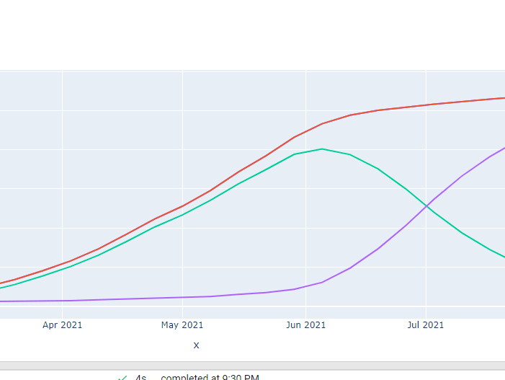
LINE GRAPH
A line graph is a graphical display of information that changes continuously over time.
We found out that the highest number have got atleast one shot if the covid vaccine.
We can observe that in September 2021 there is an increase of people who have received atleast one dose of vaccine.
Also, in June 2021 there was increase in people who have received atleast one dose.

Slide 8
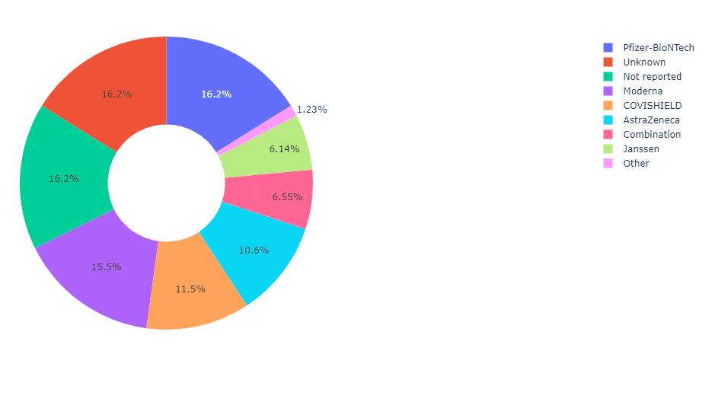
Pie chart
We found out that people have preferred Pfizer over other vaccines which is 16.2%.
Most number of people have taken Pfizer shots.
The second most preferred vaccine is Moderna.
About 15.5 % as we can see from the Pie Chart have received Moderna vaccine.
The least number of people have received Jansen.
Jansen is the least preferred vaccination.

Slide 9
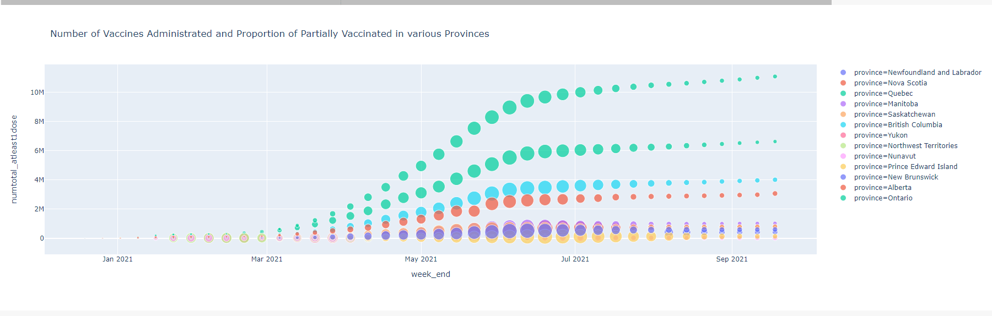
Scatter plot
The province British Columbia and Ontario has the highest number of people who have received at least one dose of vaccination.
While Prince Edward Island has the least number of people who have received at least one dose of vaccination.
From the period May 2021 to September 2021, most of the people have got their atleast one dose of vaccination.

Slide 10
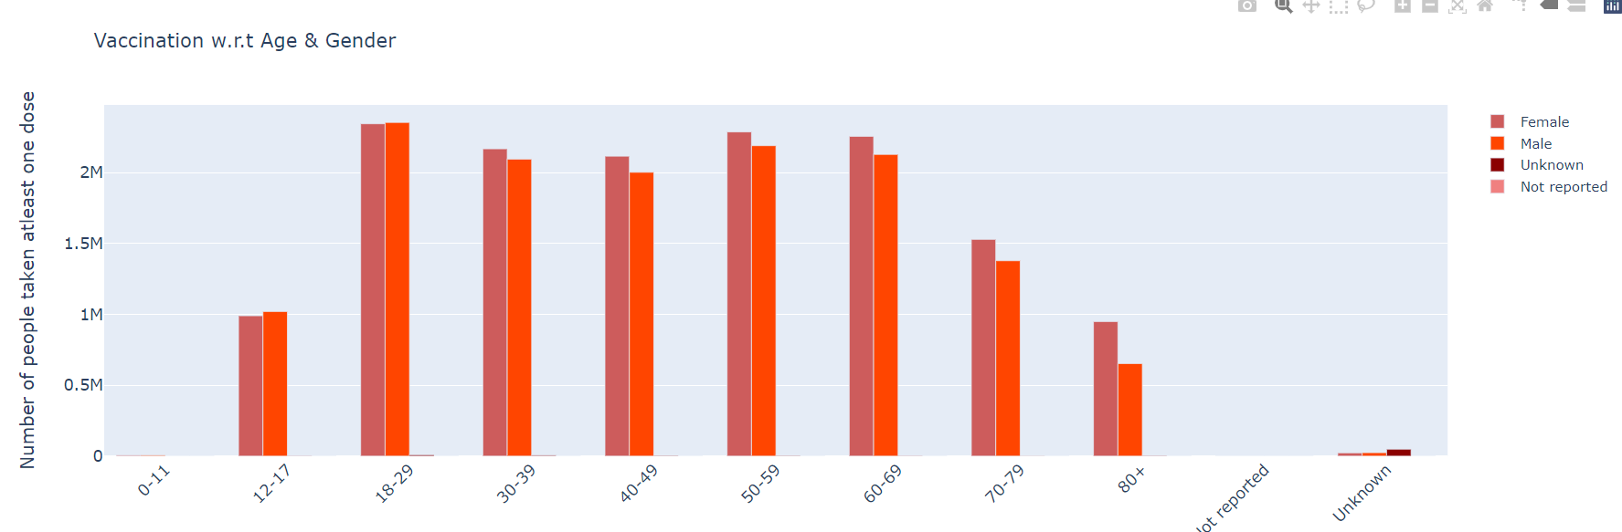
Bar Chart
From the given Bar chart representation, we can analyze the vaccine
distribution for at least one dose across different age categories across
Canada
We can see that population within the age category 18-29 inspite vaccination eligibility was initially granted to health worker and senior citizens above the age category 70

Slide 11
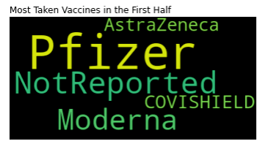
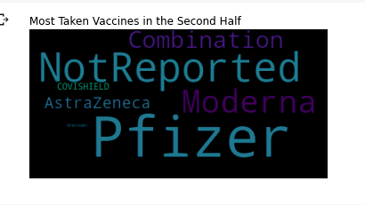
WORD CLOUD
Word clouds or tag clouds are graphical representations of word frequency that give greater prominence to words that appear more frequently in a source text
The larger the word in the visual the more common the word was in the document(s)
In the first dose, Pfizer is the most popular vaccine which has been taken by the people with at least one dose
Moderna is the second most popular vaccine taken by people
Pfizer is the still the most popular vaccine taken as second dose by the people in different provinces
Moderna is the second most popular vaccine taken as the second dose
We can see from the word cloud, combination of vaccine is preferred by the people as the second dose.

Slide 12

FB Prophet Forecasting model (feature extraction, model preparation, model evaluation, saving the model)
Prophet is a forecasting time series model by Facebook which is open source model that is basically used to predict the trend of a given data for a future timeframe
It is accurate and fast and less complex compared to ARIMA model
We would be feeding the datetime and the vaccination count features from our 3 datasets to the model
We will feed the model with a particular timeframe of the historical data in order to train the model and fetch the forecasted values for each features from the 3 datasets respectively
After getting the forecasted results we would analyse the accuracy of the model and compare it with ARIMA model to see which model performed better in terms of forecasting
The last step would be to save our model in json format so that we can deploy the model either on a cloud service or create a dashboard over the model so that the end users can see the forecasted results of the vaccination data

Slide 13
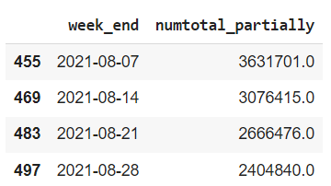
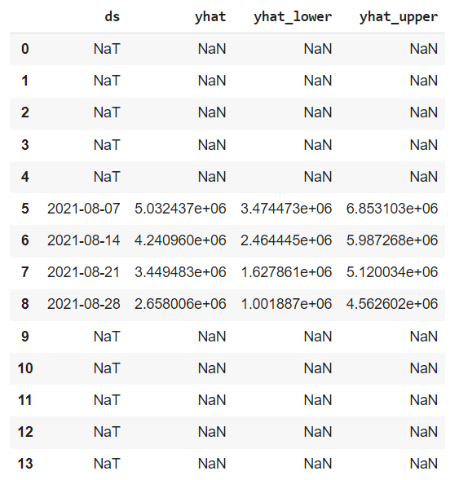
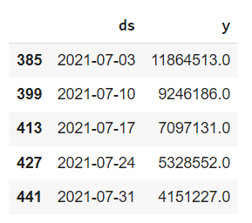
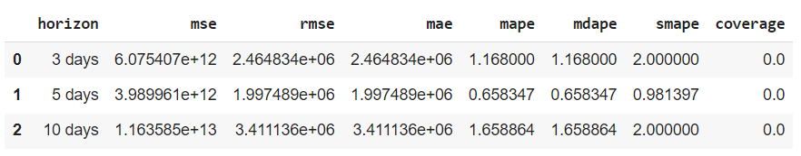
Forecasted Values
Original values
DATA SET 1
Feature Extraction
Model evaluation

Slide 14
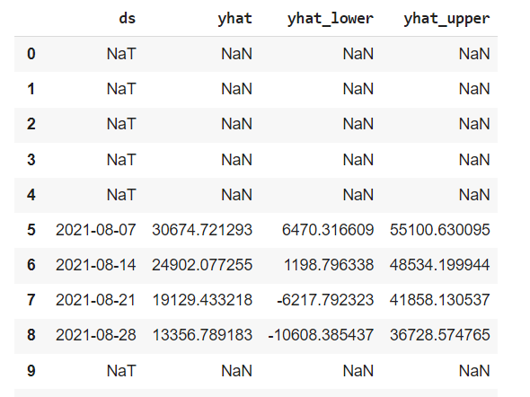
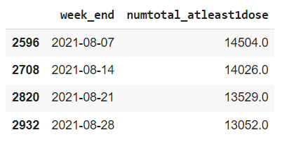
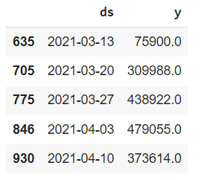
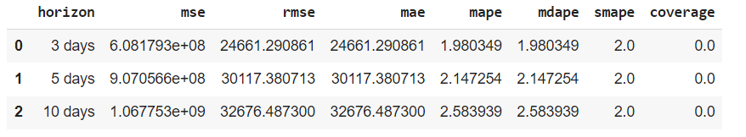
Forecasted Values
Original values
DATA SET 2
Feature Extraction
Model evaluation

Slide 15
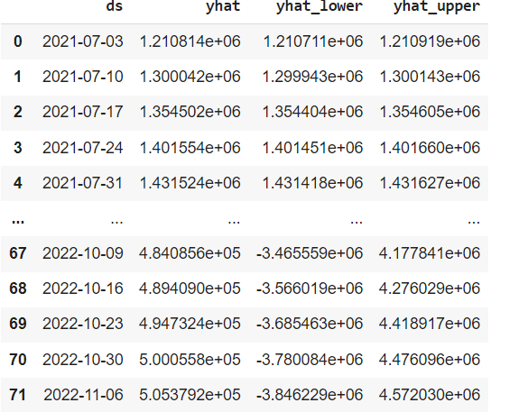
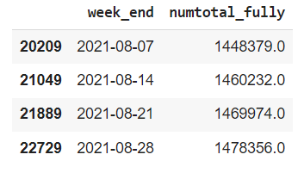
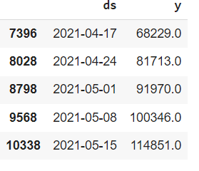
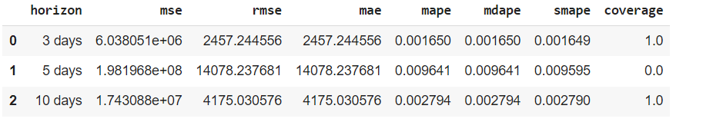
Forecasted Values
Original values
DATA SET 3
Feature Extraction
Model evaluation

Slide 16
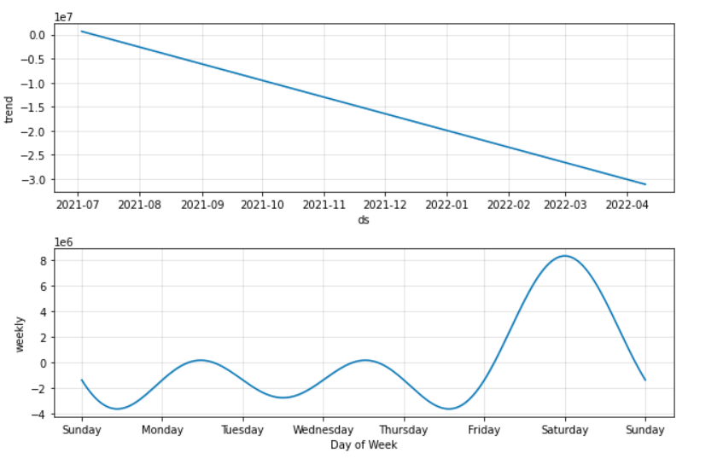
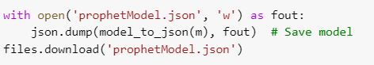
Partially vaccinated count trend
Saving the Model

